Slide 1
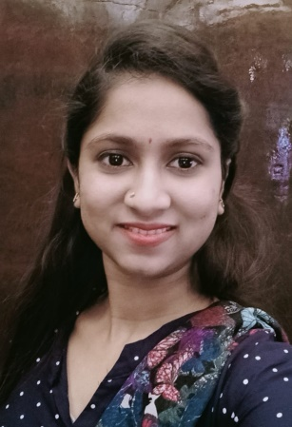
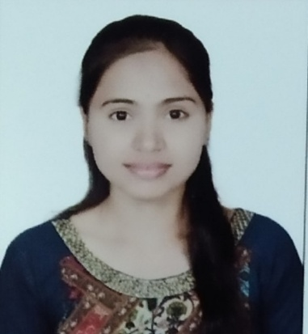

Farheen Kutubuddin Maner
Analyst/Software Engineer
Bachelor of Engineering, computer science and engineering :2017-2020
Skills
Mumbai
C# | Basics, OOP ,Exception Handling, Collection and Generics, Delegates, Events, File IO and Serialization
.NET Framework | Architecture which includes CTS,CLS and CLR
ADO.NET | Basics, Connected and Disconnected Architecture
LINQ | Basics, Queries in LINQ
Entity Framework | Establishing entity Framework
RDBMS | Basics and Advanced using SQL Server.
UI Technology | HTML5, CSS, JavaScript
Add On Skills | Team Management
ANGULAR | Components, Services, Modules, Routing, Forms & Validation
FARHEEN.KUTUBUDDIN-MANER@capgemini.com
+91 9209077295
A4
Practical understanding of RDBMS concepts using SQL Server.
Hands on experience in developing applications using .NET Framework, ADO.NET, and SQL Server
Understanding of HTML5,CSS and JavaScript.
Understanding of Angular.
Hands on experience in developing web pages using HTML,CSS,JAVASRCIPT, Angular
Full Stack developer with Angular and Full Stack .NET Developer.
Successfully completed Training in: GIT, SQL ,RDBMS, C# ,HTML5,CSS,JAVASCRIPT,ANGULAR
Successfully completed Microsoft Azure 900 (fundamental) certification
Successfully completed Microsoft Azure 104 certification
Successfully Completed Microsoft Azure 400 Certification.
Successfully completed Training in:
GIT, SQL ,RDBMS, C# ,HTML5,CSS ,JAVASCRIPT,ANGULAR
Online Railway Reservation System :
Completed case study of Online Railway Reservation System along with API Gateway, Swagger and payment, responsive UI with HTML5, CSS, Bootstrap and Angular used as User Interface.
.Doing Project For Azure Using Angular , Micrososft Visual Studio And SQL name Finops with Azure Objective is to create this app is Reduce cost of using Azure
Clic Click Me!

